Slide 1
Clean Energy Virginia Initiative
Energy Policy Roundtable in the PJM Footprint
May 23, 2018
Angela Navarro
Deputy Secretary of Commerce and Trade
Commonwealth of Virginia

Slide 2
Background
Executive Order 57: Signed in June 2016 to review concrete steps to reduce carbon from Virginia’s power plants.
The workgroup met 6 times and received over 8,000 public comments.
Executive Directive 11: Signed in May 2017 and directed DEQ to draft regulations enabling Virginia to develop a carbon reduction program that includes the following:
Provisions allowing for the trading of carbon allowances through a multi-state market; and
A corresponding level of stringency to carbon limits in other states.

Slide 3
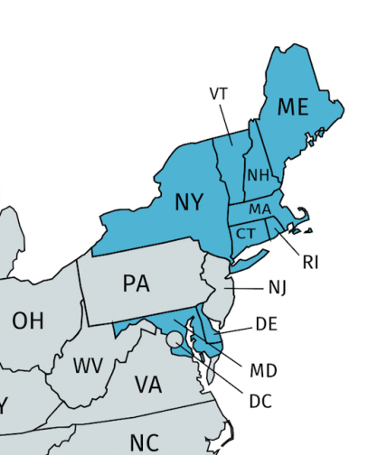
Overview of Proposal
Places carbon dioxide limits on fossil fuel fired electric generating units by 30% between 2020 and 2030.
The framework utilizes the RGGI August 2017 model rule, with additional provisions and modifications.

Slide 4
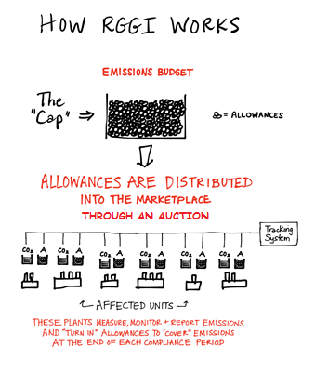
Role of the RGGI States:
Set the cap and rate of decline
Distribute allowances via the auction
Invest proceeds from the auction
Oversee compliance and enforcement
Review the program every 4 years

Slide 5
How Virginia’s Program Operates
RGGI Auction Format:
The original holder of allowances (the state) submits them to be auctioned.
The auction determines an allowance price.
The covered sources must purchase allowances to cover the amount of carbon emitted from covered units.
The auction revenue from the sale of allowances is reimbursed to the state.
Virginia’s Program:
Virginia allocates allowances to covered sources.
The covered sources consign the allowances to the RGGI quarterly auctions.
The covered source must also purchase allowances to cover the amount of carbon emitted from covered units.
The difference between what is sold and what is purchased is distributed back to the covered source.

Slide 6
Allowance Allocation
95% of the allowances will be allocated to covered units to be consigned to the RGGI quarterly auctions.
The proposed regulation applies to fossil fuel fired electric generating units that are 25 megawatts and greater.
Fossil fuels must constitute 10% or more of the total fuel mix.
5% of the allowances will be allocated to the Department of Mines Minerals and Energy for carbon abatement programs.

Slide 7
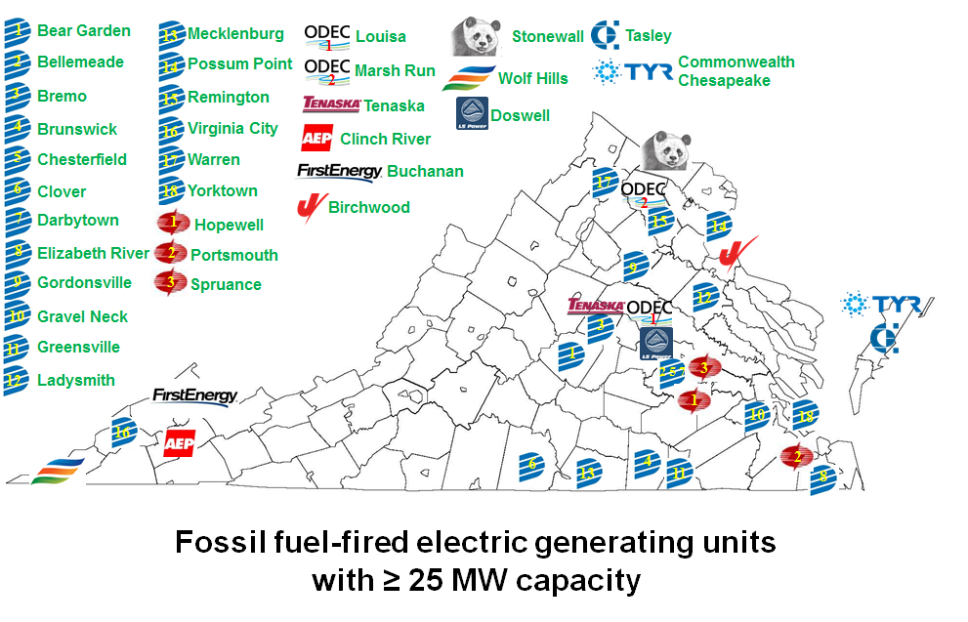
Covered Units

Slide 8
Timeline
June 26, 2017: Notice of Intended Regulatory Action (NOIRA) published in Virginia Register
June 26, 2017 – July 26, 2017: Public comment period
August – September, 2017: Regulatory Advisory Panel (RAP)
3 separate meetings
November 16: Air Pollution Control Board approved the regulation
January 8, 2018: Draft regulation published in the Virginia Register
90 day public comment period ended April 9, 2018
March 7, 2018 – March 19, 2018: Six public hearings throughout Virginia

